Slide 1





FourPaths
You are more than
your job title
Your skills. Your experience.
Your next opportunity.
FourPaths helps you explore where your
experience fits and what to do next.
Notes:
NARRATION
You have more valuable skills, experience and knowledge than your job title can express. FourPaths helps you turn those assets into possibilities for your next opportunity, and a practical first step toward it. I'm Armando Viteri, co-creator of FourPaths and CEO of Neubloc. We built FourPaths around a simple question: what could someone do with everything they have learned? For organizations that help people move forward, that question opens an opportunity to deliver a valuable new service.
PRESENTER NOTES AND SOURCES
FourPaths helps people explore possible directions and develop a reviewable Decision Brief. The message concerns potential uses of accumulated experience, without guaranteeing a particular opportunity or income.
FourPaths supplied website package dated October 1, 2026, including product descriptions, partner page and sample Decision Briefs. Original imagery retained from that website. Product destinations: https://vocatio.fourpaths.ai/ ; https://polis.fourpaths.ai/ ; https://fama.fourpaths.ai/ ; https://artifex.fourpaths.ai/ .

Slide 2
FourPaths
FOUR POSSIBLE DIRECTIONS
02
Four ways to put your experience to work
VOCATIO
POLIS
Find the right
next career move
Determine whether you have
a business worth building
FAMA
ARTIFEX
Turn what you know into an
audience and creator business
Turn your expertise into a
service or independent income
Each Path produces a written Decision Brief to review and act on.
Notes:
NARRATION
FourPaths makes the possibilities easier to understand through four distinct directions. VOCATIO helps you find the right next career move. POLIS helps you determine whether you have a business worth building. FAMA helps you turn what you know into an audience and creator business. ARTIFEX helps you turn your expertise into a service or independent income. You can begin with the direction that matters to you. Each Path brings a different set of questions to the experience and knowledge you already possess.
PRESENTER NOTES AND SOURCES
VOCATIO: professional career exploration. POLIS: business creation. FAMA: creator business. ARTIFEX: independent services. Plain-English descriptions are the primary explanations. A person can explore selected Paths. This presentation does not claim an automated cross-Path ranking engine.
FourPaths supplied website package dated October 1, 2026, including product descriptions, partner page and sample Decision Briefs. Original imagery retained from that website. Product destinations: https://vocatio.fourpaths.ai/ ; https://polis.fourpaths.ai/ ; https://fama.fourpaths.ai/ ; https://artifex.fourpaths.ai/ .

Slide 3
FourPaths
ONE PERSON, FOUR OPTIONS
03
One person. Four possible directions
Sam’s experience
Path | Possible direction / income | First test
Career VOCATIO | Operations leadership Salary | Speak with employers
Business POLIS | Freight visibility service Service subscriptions | Interview likely buyers
Creator FAMA | Logistics lessons Courses or memberships | Publish a useful lesson
Services ARTIFEX | Workflow reviews Project fees | Offer a small paid review
Freight operations
Customer relationships
Solving workflow problems
His constraint
Protect essential income
while testing a next step.
Fictional example. Directions and income models are possibilities to investigate, not verified opportunities or earnings forecasts.
Notes:
NARRATION
Consider Sam, a fictional logistics professional. His job title describes one role. His experience includes solving operational problems, understanding customers and coordinating work. Those same assets could support an operations leadership position, a freight-visibility business, practical lessons for an audience, or an independent workflow-review service. Each possibility requires a different investigation. Sam also needs to protect his essential income. The opportunity begins with recognizing that his accumulated experience could have several valuable applications, then deciding which one deserves a closer look.
PRESENTER NOTES AND SOURCES
Sam is a fictional logistics professional in the supplied POLIS sample. The four possible directions and earning models are illustrative hypotheses for discussion. Salary, service subscriptions, courses/memberships and project fees are possible models, not verified offers or earnings forecasts. First tests are proposed, not completed.
FourPaths supplied website package dated October 1, 2026, including product descriptions, partner page and sample Decision Briefs. Original imagery retained from that website. Product destinations: https://vocatio.fourpaths.ai/ ; https://polis.fourpaths.ai/ ; https://fama.fourpaths.ai/ ; https://artifex.fourpaths.ai/ .

Slide 4
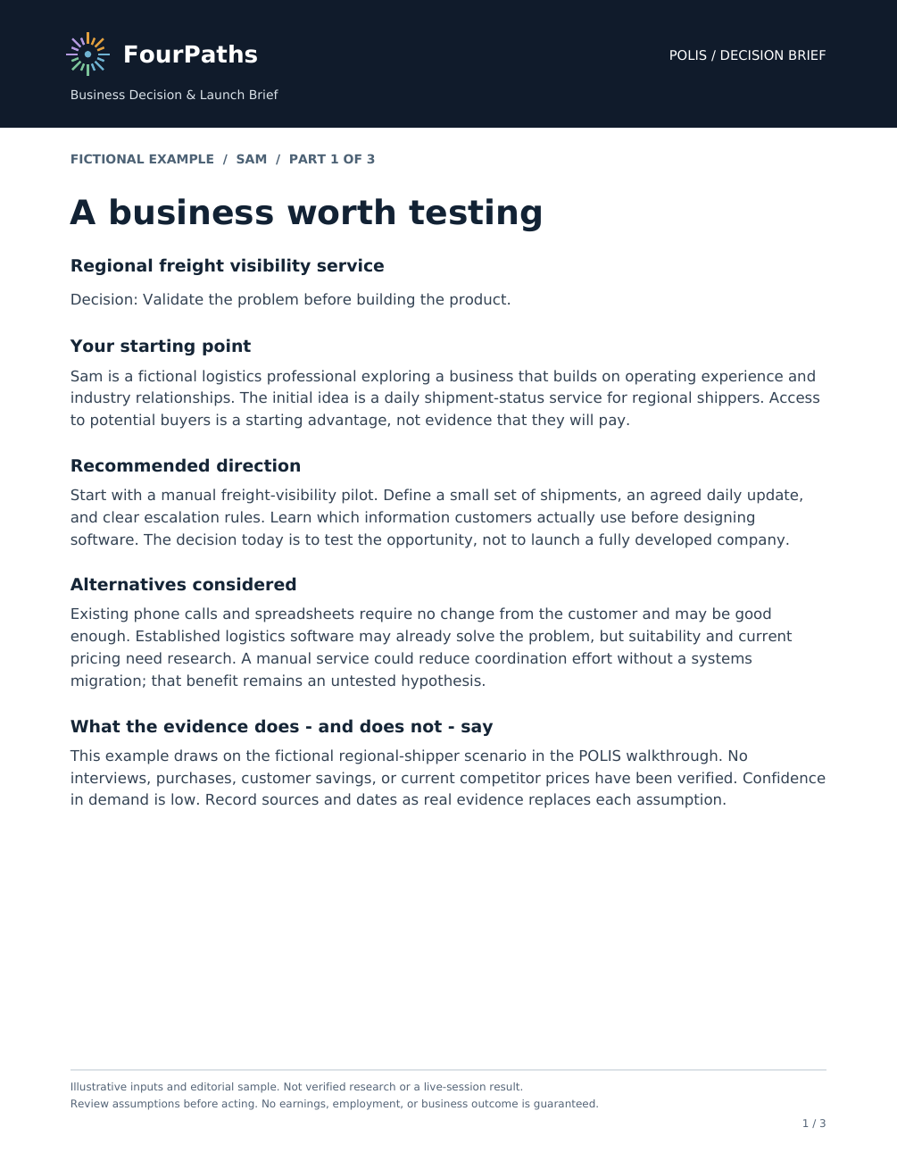
FourPaths
THE ACTUAL OUTPUT
04
A next step you can see and discuss
Sam’s business idea
A regional freight visibility service
Why it could fit
Relevant experience and buyer relationships
How it might earn
Service fees, with price and effort to test
What needs proof
Demand, alternatives, costs and delivery time
Three proposed next actions
1 Interview five shipper contacts
2 Check willingness to pay and delivery effort
3 Test a small manual pilot before building software
Original POLIS sample, page 1 of 3. Sam is fictional. Summary and proposed actions draw on the full sample and advisor review.
Notes:
NARRATION
This is the actual sample POLIS Decision Brief from the FourPaths website. Sam is considering a regional freight-visibility service. The brief examines assumptions, costs and delivery time, and recommends testing a manual service before investing in software. Three proposed actions make the next step concrete: interview five relevant shipper contacts; investigate willingness to pay and the time needed to serve them; and test a small manual pilot. These are proposed investigations. The brief gives Sam and his advisor a useful starting point.
PRESENTER NOTES AND SOURCES
The image is page one of the original three-page POLIS sample Decision Brief, supplied at /briefs/polis/FourPaths_POLIS_Decision_Brief.pdf. Sam is fictional. The sample considers a manual regional shipment-status service, alternatives, costs, delivery time and evidence gaps. The summary draws on all three pages. The three next steps on this slide are proposed validation actions, not customer results. Willingness to pay must be investigated. The document is a working brief for discussion and testing.
FourPaths supplied website package dated October 1, 2026, including product descriptions, partner page and sample Decision Briefs. Original imagery retained from that website. Product destinations: https://vocatio.fourpaths.ai/ ; https://polis.fourpaths.ai/ ; https://fama.fourpaths.ai/ ; https://artifex.fourpaths.ai/ .

Slide 5
FourPaths
THE PROCESS
05
A guided process for a real decision
01
02
03
04
Your situation
A chosen Path
Your written brief
A first test
Experience, goals,
income needs and
practical constraints
Questions that fit
the decision you
want to examine
A direction, reasons,
risks and actions
to review
A real conversation
or small experiment
with your advisor’s help
The next step produces evidence you can use.
Notes:
NARRATION
The process starts with the person: their experience, interests, goals and circumstances. Income needs, available time and appetite for risk all matter. A chosen Path guides the exploration through questions relevant to that decision. The resulting brief makes the direction and reasoning available for review. Then comes the essential next step: testing the idea in the world. That might mean an employer conversation, a customer interview or a small engagement. Progress comes from a manageable action that produces something useful to learn.
PRESENTER NOTES AND SOURCES
The client supplies background and circumstances, explores a chosen Path, receives a brief and reviews next steps. Customer or employer conversations and other real-world tests are undertaken by the person and advisor. The product does not guarantee the result of those tests.
FourPaths supplied website package dated October 1, 2026, including product descriptions, partner page and sample Decision Briefs. Original imagery retained from that website. Product destinations: https://vocatio.fourpaths.ai/ ; https://polis.fourpaths.ai/ ; https://fama.fourpaths.ai/ ; https://artifex.fourpaths.ai/ .

Slide 6
FourPaths
CAREER AND BUSINESS
06
A career move. A business worth building
VOCATIO
POLIS
Your next career move
A business worth building
Transferable skills, options and gaps
A focused search and action plan
Customers, alternatives and economics
A first test before a larger commitment
Career Direction and Action Brief
Business Decision and Launch Brief
Notes:
NARRATION
VOCATIO focuses on your next career move. It helps you examine transferable skills, possible directions, gaps and a focused action plan. You may discover that experience acquired in one role has value in another. POLIS focuses on a business worth building. It explores the customer, the problem, existing alternatives and the economics of a proposed offering. A promising idea becomes a set of questions to investigate. Sometimes the sensible first step is a small experiment that protects your time and resources.
PRESENTER NOTES AND SOURCES
VOCATIO takes its name from the Latin for a calling or summons. POLIS is the Greek city or city-state. VOCATIO produces a Career Direction and Action Brief. POLIS produces a Business Decision and Launch Brief. Names and etymology support the brand while plain-English function leads the slide.
FourPaths supplied website package dated October 1, 2026, including product descriptions, partner page and sample Decision Briefs. Original imagery retained from that website. Product destinations: https://vocatio.fourpaths.ai/ ; https://polis.fourpaths.ai/ ; https://fama.fourpaths.ai/ ; https://artifex.fourpaths.ai/ .

Slide 7
FourPaths
CREATOR AND INDEPENDENT
07
An audience. An independent service
FAMA
ARTIFEX
An audience and creator business
A service and independent income
What to create and whom to serve
Revenue models to investigate
An offering, customers and delivery effort
Earnings after costs and unpaid time
Created work that serves an audience
Expertise delivered as a service
Notes:
NARRATION
FAMA explores how what you know could serve an audience. That might be practical education, a specialist publication or content built around a craft. It helps you consider whom to serve, what to create and possible revenue models. ARTIFEX explores expertise delivered as a service: consulting, fractional work or another independent offering. It brings attention to potential customers, delivery effort and earnings after expenses and unpaid time. These are different ways to create value, with different demands on the person pursuing them.
PRESENTER NOTES AND SOURCES
FAMA means reputation or renown. ARTIFEX means craftsperson or artisan. FAMA concerns value delivered through created work and an audience. ARTIFEX concerns value delivered through an independent service. Revenue models are possibilities to investigate, not income guarantees.
FourPaths supplied website package dated October 1, 2026, including product descriptions, partner page and sample Decision Briefs. Original imagery retained from that website. Product destinations: https://vocatio.fourpaths.ai/ ; https://polis.fourpaths.ai/ ; https://fama.fourpaths.ai/ ; https://artifex.fourpaths.ai/ .

Slide 8
FourPaths
WHY FOURPATHS
08
Guidance built around a decision
A defined process
Your circumstances
Questions appropriate to the Path
you want to explore.
Experience, income needs and
constraints shape the discussion.
Evidence and gaps
A usable outcome
Reasons to consider a direction,
and assumptions that need testing.
A written brief you can review
with an advisor and act on.
Important facts require review. Real-world tests help establish whether an opportunity deserves further commitment.
Notes:
NARRATION
What makes the process useful is the structure around the decision. A defined Path focuses the questions. The investigation makes room for personal constraints, available evidence and information still missing. A written brief preserves the reasoning so it can be examined, challenged and improved. People and their advisors can verify important facts and test assumptions before committing. FourPaths gives that work a practical shape: a clearer question, an explicit direction to consider, and an output that supports a productive conversation and next action.
PRESENTER NOTES AND SOURCES
Product differentiation is the dedicated process and deliverable: decision-specific questions, consideration of a person’s situation, investigation of evidence and gaps, and a written brief that supports review and action. Important facts and claims remain subject to verification.
Presenter FAQ: Why not ask ChatGPT? A general-purpose assistant can help brainstorm and structure research. FourPaths gives people a purpose-built decision process and a consistent written outcome that an advisor can use in a service. The comparison concerns the experience and workflow. No claim is made that a foundation model is incapable of these tasks or that comparative outcome superiority has been measured.
FourPaths supplied website package dated October 1, 2026, including product descriptions, partner page and sample Decision Briefs. Original imagery retained from that website. Product destinations: https://vocatio.fourpaths.ai/ ; https://polis.fourpaths.ai/ ; https://fama.fourpaths.ai/ ; https://artifex.fourpaths.ai/ .

Slide 9
FourPaths
THE PERSONAL DECISION
09
Which opportunity fits your life?
Explore one Path or review several briefs with an advisor.
Income
Time and investment
How soon must it earn?
What income do you need to protect?
What can you commit alongside
your current responsibilities?
Risk
Flexibility
What assumptions matter most?
What could you afford to lose?
Can you test it on a small scale?
How easily could you change course?
Notes:
NARRATION
An attractive opportunity still has to fit a real life. Sam and his advisor can examine possible directions against the same practical considerations. How soon does he need income? How much time and money can he commit? What could go wrong? How easily could he change course? A career move, a new business and a small service engagement may produce very different answers. Comparing those tradeoffs helps him decide where to begin. The right next step should reflect both his ambition and his circumstances.
PRESENTER NOTES AND SOURCES
This is a framework for a person and advisor to compare possible directions or multiple briefs. It is not an automated cross-Path score or ranking. Discuss income timing, available effort, downside and reversibility before making a significant commitment.
FourPaths supplied website package dated October 1, 2026, including product descriptions, partner page and sample Decision Briefs. Original imagery retained from that website. Product destinations: https://vocatio.fourpaths.ai/ ; https://polis.fourpaths.ai/ ; https://fama.fourpaths.ai/ ; https://artifex.fourpaths.ai/ .

Slide 10
FourPaths
WHY NOW
10
The possibilities are changing
One person can attempt more
More need to adapt
1 person + AI
59 in 100
Matched a two-person team without AI
on product-innovation tasks.
Workers expected to need training
by 2030, according to employers.
Field experiment with 791 P&G professionals
WEF Future of Jobs Report 2025 forecast
What could these changes make possible for you?
Sources: Organization Science (2026), The Cybernetic Teammate; WEF Future of Jobs Report 2025. Task-specific result; employer forecast.
Notes:
NARRATION
The timing matters because both the demands and possibilities of work are changing. In a study involving 791 Procter and Gamble professionals, individuals using AI matched teams of two working without it on a product-innovation task. That illustrates an expansion in what individuals may attempt. At the same time, the World Economic Forum's 2025 report projected that 59 out of every 100 workers would need training by 2030. People need a practical way to explore what those changes could mean for their own lives.
PRESENTER NOTES AND SOURCES
The Cybernetic Teammate field experiment analyzed 791 Procter & Gamble professionals. Individuals using AI matched two-person teams without AI on product-innovation tasks. This does not establish replacement of all company functions. Organization Science, published June 12, 2026. https://pubsonline.informs.org/doi/10.1287/orsc.2025.20702
WEF Future of Jobs Report 2025, based on employer expectations, projects that 59 of 100 workers would require training by 2030 across the report’s macroeconomic trends. This is a forecast, not an observed outcome or AI-only estimate. https://www.weforum.org/publications/the-future-of-jobs-report-2025/digest/
The inference is that changing work creates both new possibilities and a need for informed personal decisions. Sources checked October 5, 2026, America/Phoenix.
FourPaths supplied website package dated October 1, 2026, including product descriptions, partner page and sample Decision Briefs. Original imagery retained from that website. Product destinations: https://vocatio.fourpaths.ai/ ; https://polis.fourpaths.ai/ ; https://fama.fourpaths.ai/ ; https://artifex.fourpaths.ai/ .

Slide 11
FourPaths
THE ADVISOR’S ROLE
11
A stronger starting point for your advisors
FourPaths contributes
Your advisors contribute
Structured exploration
A direction and supporting reasoning
A reviewable Decision Brief
Context and professional judgment
Challenge to weak assumptions
Relationships and accountability
A specific conversation about a real next step
Review the brief. Agree a test. Return to what the client learned.
Notes:
NARRATION
For a partner organization, the Decision Brief gives an advisor something concrete to work with. The advisor adds context the client may be missing, challenges weak assumptions and helps decide what evidence to seek. They can also bring relationships, local knowledge and accountability. Together, client and advisor agree an achievable next action and return to what was learned. FourPaths supports that conversation through structured exploration and a reviewable output. Your organization's expertise helps turn the starting point into progress for the person you serve.
PRESENTER NOTES AND SOURCES
The proposed partner workflow gives advisors a brief to review. They bring context, challenge assumptions, check consequential facts, suggest introductions and support follow-through. Time savings and improved outcomes require measurement in a pilot.
FourPaths supplied website package dated October 1, 2026, including product descriptions, partner page and sample Decision Briefs. Original imagery retained from that website. Product destinations: https://vocatio.fourpaths.ai/ ; https://polis.fourpaths.ai/ ; https://fama.fourpaths.ai/ ; https://artifex.fourpaths.ai/ .

Slide 12
FourPaths
YOUR AUDIENCE
12
Serve the people you already support
Partner | Client need | Potential FourPaths offer
Coaches, recruiters and outplacement firms | A next chapter after change | Career exploration with alternative income options
Universities and workforce organizations | A direction worth preparing for | Skills-to-opportunity workshop and advisor review
Employers and HR advisory firms | Development and transitions | Career planning or transition program using selected Paths
Associations and enterprise-support firms | Member value and viable ventures | Member exploration program or venture-exploration service
The audience determines the appropriate Paths and advisory service.
Notes:
NARRATION
This can fit several established services. Career firms and coaches can use it to broaden a client's next-step exploration. Workforce and outplacement organizations can help people examine ways to apply their experience. Universities can support students and alumni considering different working lives. Employers can introduce another resource for development conversations. Associations can help members explore new applications of their expertise. The audience and service design should determine the appropriate Paths. A focused offering for a clearly understood group is a sensible place to begin.
PRESENTER NOTES AND SOURCES
These are potential applications for audiences that career firms, workforce providers, universities, employers and associations already serve. Paths and service scope should fit the audience. No existing partnerships are implied.
FourPaths supplied website package dated October 1, 2026, including product descriptions, partner page and sample Decision Briefs. Original imagery retained from that website. Product destinations: https://vocatio.fourpaths.ai/ ; https://polis.fourpaths.ai/ ; https://fama.fourpaths.ai/ ; https://artifex.fourpaths.ai/ .

Slide 13
FourPaths
THE SERVICE OPPORTUNITY
13
Build a valuable new service offering
01
02
03
Brief + advisor review
Guided program
Sponsored cohort
Bundle the exploration and
review into an existing service.
Add follow-through as clients
test a possible direction.
Serve a group funded by an
employer, college or association.
Your brand. Your audience. A defined service.
$5.34bn
Annual global professional coaching revenue
ICF 2025 sector context, not a FourPaths market-size estimate
Potential service models. Access, branding, distribution, support and commercial terms to agree. Source: ICF Global Coaching Study 2025.
Notes:
NARRATION
There are several potential ways to package a paid service. A brief and advisor review can become part of an existing engagement. A guided program can add structured follow-through as clients investigate their options. An employer, university or association could sponsor a cohort. The FourPaths website also demonstrates how partner branding can support the experience. Access, support, branding and commercial terms would be agreed together. The business opportunity is to deliver a useful service that customers understand, with economics that work for your organization.
PRESENTER NOTES AND SOURCES
Potential models include a brief plus advisor review, a guided program, and a sponsored cohort. Branded access or resale can be discussed with FourPaths. Pricing, rights, support and commercial terms require agreement.
ICF Global Coaching Study 2025 estimates annual global professional coaching revenue of $5.34 billion. This is sector context, not FourPaths’ addressable market or a revenue forecast. https://coachingfederation.org/blog/global-coaching-industry-surpasses-5-34-billion-as-emerging-markets-drive-growth/ . Source checked October 5, 2026, America/Phoenix.
FourPaths supplied website package dated October 1, 2026, including product descriptions, partner page and sample Decision Briefs. Original imagery retained from that website. Product destinations: https://vocatio.fourpaths.ai/ ; https://polis.fourpaths.ai/ ; https://fama.fourpaths.ai/ ; https://artifex.fourpaths.ai/ .

Slide 14
FourPaths
A MEASURABLE PILOT
14
A pilot makes the value measurable
One audience. Selected Paths. A clear advisory offer.
Client progress
Partner economics
Completion and clarity
An agreed next action
Follow-through and useful evidence
Advisor time and support effort
Revenue and actual delivery costs
Reasons to renew or expand
Agree the measures before launch. Improve the offer using what you learn.
Notes:
NARRATION
A pilot should make the opportunity measurable. Choose one audience, the relevant Paths and a clear advisory offering. Agree what successful participation looks like and how the service will be delivered. Then track completion, client-rated clarity, agreed next actions and follow-through. Review the partner's delivery effort, support requirements, revenue and costs alongside those measures. This gives us evidence about client value and practical economics. We can use what the pilot teaches us to improve the offering and decide how it should grow.
PRESENTER NOTES AND SOURCES
Suggested pilot measures are participation/completion, client-rated clarity, agreed next steps, follow-through, advisor time, support burden, actual revenue and actual delivery costs. Longer-term income and career outcomes need separate follow-up. These are evaluation measures, not existing results.
FourPaths supplied website package dated October 1, 2026, including product descriptions, partner page and sample Decision Briefs. Original imagery retained from that website. Product destinations: https://vocatio.fourpaths.ai/ ; https://polis.fourpaths.ai/ ; https://fama.fourpaths.ai/ ; https://artifex.fourpaths.ai/ .

Slide 15
FourPaths
THE PARTNERSHIP
15
Help people see what they could become
FourPaths
Your organization
A structured way to explore
A direction worth examining
A practical next step
Trusted relationships
Professional judgment
Support that helps people follow through
More possibilities for the person.
A valuable new service for your firm.
Let’s design a pilot for the people you serve.
Marc Lessen / marc.lessen@gmail.com
Armando Viteri / armando5@earthlink.net
Notes:
NARRATION
The larger opportunity is to help people recognize possibilities they could not previously see in themselves, and take a considered step toward them. FourPaths brings a structured way to explore. Your organization brings trusted relationships, judgment and support. Together, we can give individuals a clearer direction while creating a valuable service for your firm. Let's begin with the people you serve, choose an opportunity to help them, and design a FourPaths pilot that makes the value visible.
PRESENTER NOTES AND SOURCES
The proposed partnership combines structured exploration with human judgment and support. Better lives and a valuable service are the ambition. A focused pilot is the next step to test the proposition. Marc Lessen and Armando Viteri are FourPaths co-creators. Contact details are retained from the supplied website and original presentation.
FourPaths supplied website package dated October 1, 2026, including product descriptions, partner page and sample Decision Briefs. Original imagery retained from that website. Product destinations: https://vocatio.fourpaths.ai/ ; https://polis.fourpaths.ai/ ; https://fama.fourpaths.ai/ ; https://artifex.fourpaths.ai/ .

